Slide 1
Lecture: Graph Traversals (BFS, DFS)

Slide 2
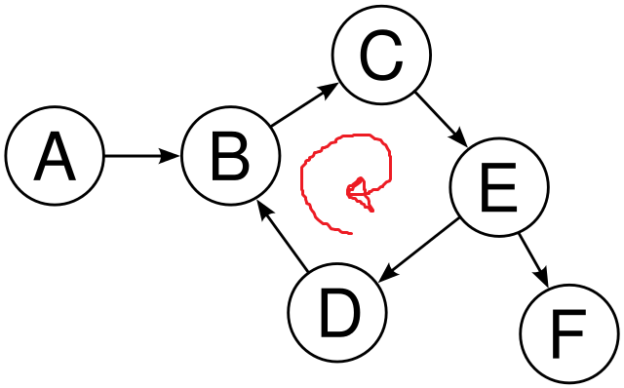
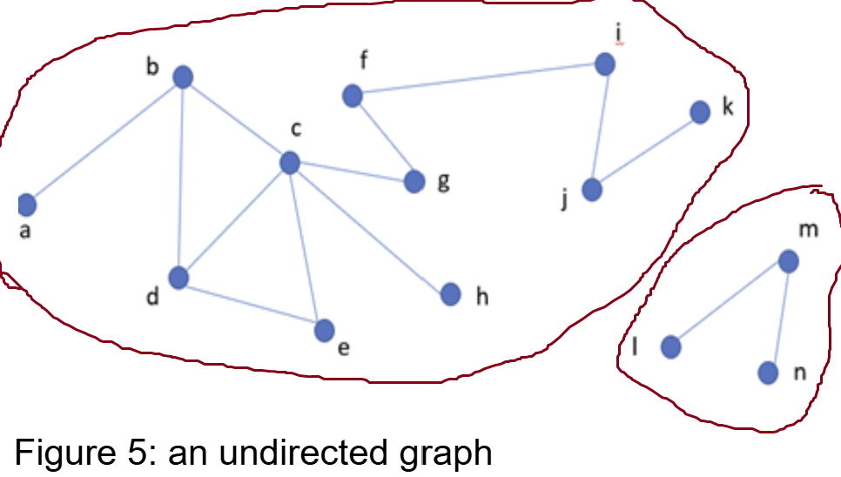
Graph traversals
Graph Traversal Purpose:
Given a graph G=(V,E) and a starting vertex s
Visit each vertex v∈V exactly once
Difference from Trees:
Graphs may contain cycles → risk of infinite recursion.
Graphs may be disconnected → not all vertices are reachable from one source.

Slide 3
Graph traversals
Difference from Trees:
Graphs may contain cycles → can lead to infinite recursion or repeated traversal.
Solution: Use a visited array/list to keep track of vertices that have already been visited or added to the stack/queue.
Graphs may be disconnected → → not all vertices are reachable from a single source vertex.
Solution: The graph representation (adjacency matrix/list) stores information about all vertices and edges, allowing traversal to restart from unvisited vertices if needed.

Slide 4


Graph traversals
(Important!!!)
Two common graph traversal algorithms: BFS & DFS
Breadth-First Search (BFS) Start with the source vertex [always] Explores breadth-first (level-wise) Visits all neighbors at the current level before moving to the next. [Similar to ripple effect in water] Uses Queue (FIFO) | Depth-First Search (DFS) Start with the source vertex [always] Explores depth-first, following one path as far as possible before backtracking when all neighboring nodes have been visited (no further choices remain). Recursively visit each neighbor (Recursive call stack) Uses Stack (LIFO)

Slide 5
Vertex Selection Rules in Traversal
Alphabetical options: Follow alphabetical order
Numerical options: Follow stated order (ascending/descending).
No order given / mentioned: Select any option (any neighboring node you want).
Always follow the traversal order specified in the question.
[Failure to follow the specified order will result in no marks.]

Slide 6
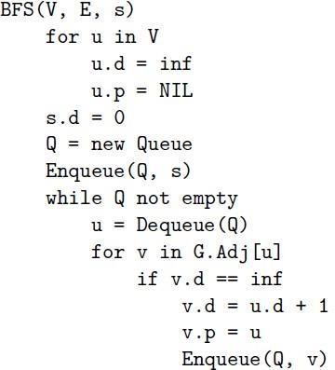
Breadth first search (BFS)
d [u ]: the distance from source
π[u ] or p[u ]: the predecessor of u

Slide 7
Breadth first search (BFS)
Information during traversal
color [u]: the color of each vertex visited (For skipping visited nodes)
  white: undiscovered
  gray: discovered but not finished processing
  black: finished processing
π[u ] or p[u ]: the predecessor of u
d [u ]: the distance from source

Slide 8
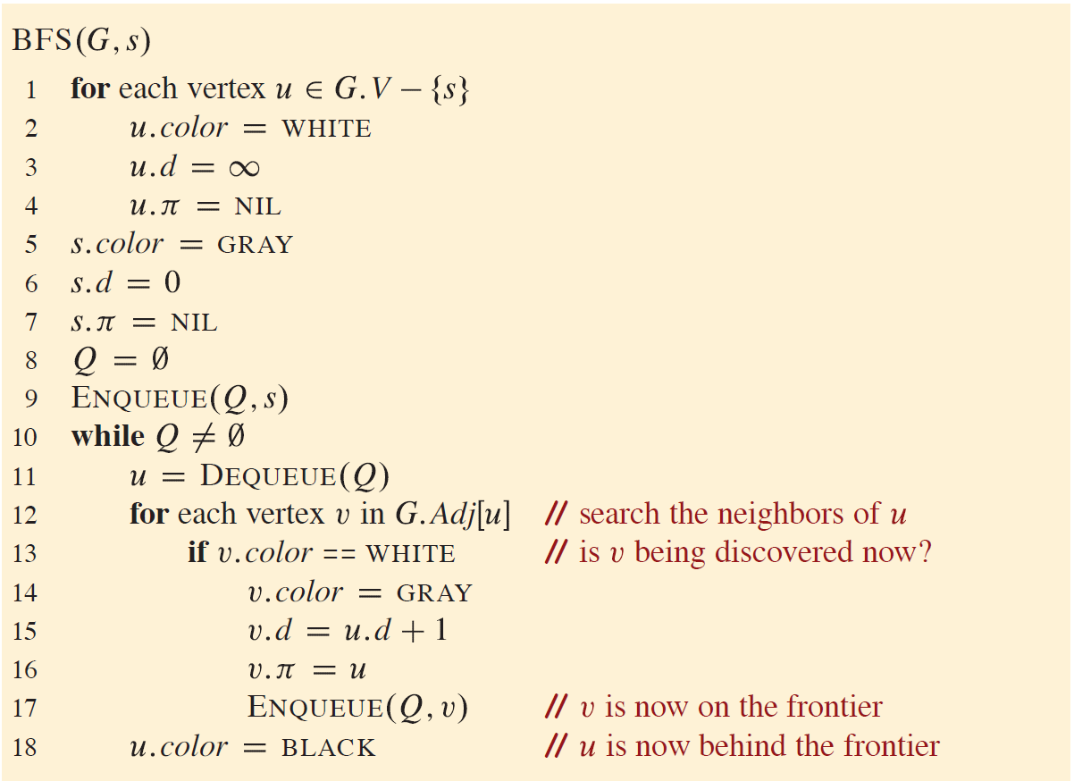
Breadth first search (BFS)

Slide 9
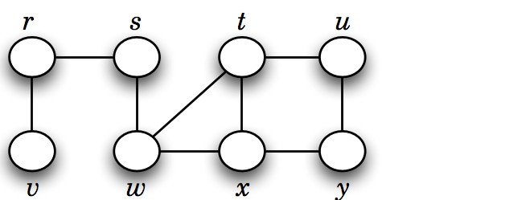
Basic idea behind breadth first search (BFS)
Given a graph G = (V , E ), and a distinguished vertex s (source), systematically visit each vertex v ∈ V that is reachable from s.
Builds a BFS tree over the graph starting from a source vertex.

Slide 10
Breadth-first search (Simulation 1)

Slide 11
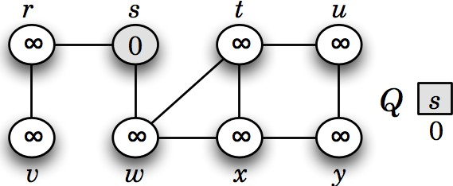
Breadth-first search (Simulation 1)
Visited: s
Here, front of queue is on left side. Hence, dequeue from left (front) and enqueue from right (rear of queue)

Slide 12
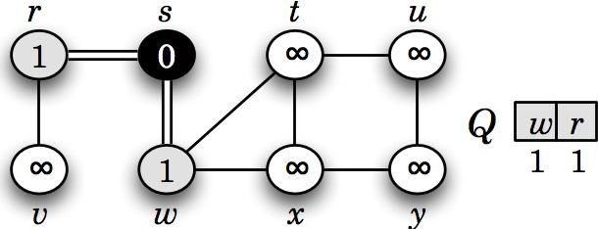
Breadth-first search (Simulation 1)
Visited: s, w, r
Here, front of queue is on left side. Hence, dequeue from left (front) and enqueue from right (rear of queue)

Slide 13
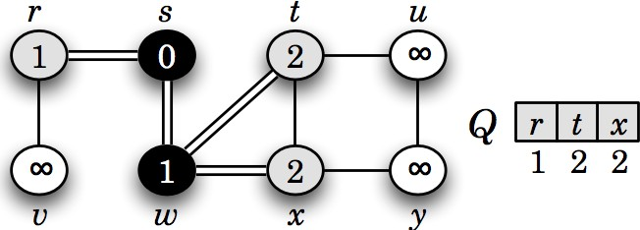
Breadth-first search (Simulation 1)
Visited: s, w, r, t, x
Here, front of queue is on left side. Hence, dequeue from left (front) and enqueue from right (rear of queue)

Slide 14
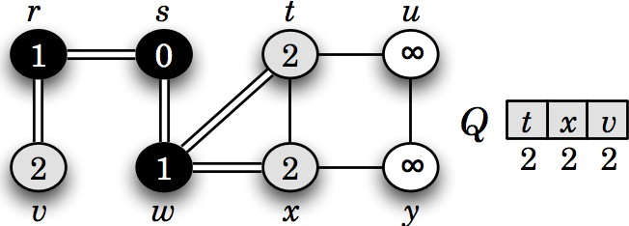
Breadth-first search (Simulation 1)
Visited: s, w, r, t, x, v
Here, front of queue is on left side. Hence, dequeue from left (front) and enqueue from right (rear of queue)

Slide 15
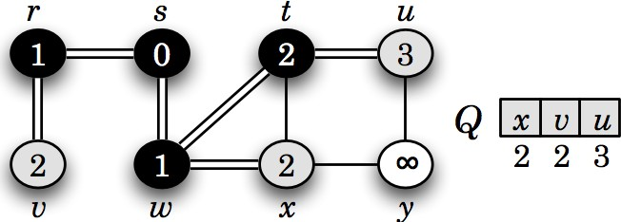
Breadth-first search (Simulation 1)
Visited: s, w, r, t, x, v, u
Here, front of queue is on left side. Hence, dequeue from left (front) and enqueue from right (rear of queue)

Slide 16
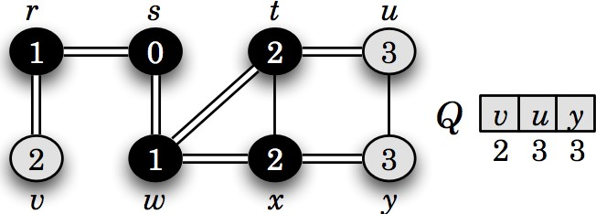
Breadth-first search (Simulation 1)
Visited: s, w, r, t, x, v, u, y
Here, front of queue is on left side. Hence, dequeue from left (front) and enqueue from right (rear of queue)

Slide 17
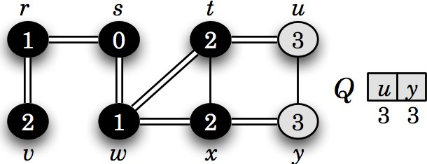
Breadth-first search (Simulation 1)
Visited: s, w, r, t, x, v, u, y
Here, front of queue is on left side. Hence, dequeue from left (front) and enqueue from right (rear of queue)

Slide 18
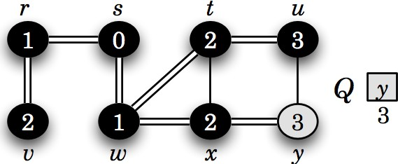
Breadth-first search (Simulation 1)
Visited: s, w, r, t, x, v, u, y
Here, front of queue is on left side. Hence, dequeue from left (front) and enqueue from right (rear of queue)

Slide 19
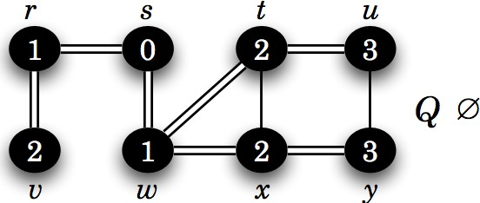
Breadth-first search (Simulation 1)
Visited: s, w, r, t, x, v, u, y
Here, front of queue is on left side. Hence, dequeue from left (front) and enqueue from right (rear of queue)

Slide 20
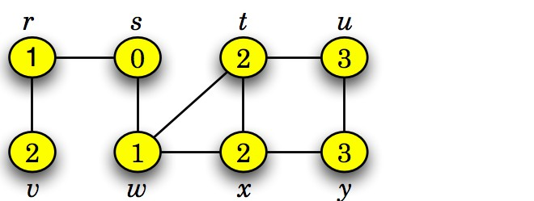
Breadth first search (BFS)
This graph G = (V , E ) is connected,
since BFS visits all vertices v ∈ V starting from s.
BFS also finds the shortest path (fewest edges) from s to any other vertex t.

Slide 21
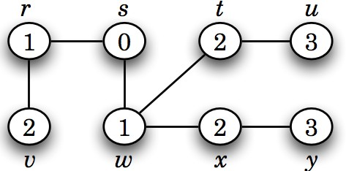
Breadth first search (BFS) Tree
A BFS tree is a tree formed during BFS that shows the shortest paths (in terms of edges) from the source vertex to all other reachable vertices in the graph.

Slide 22
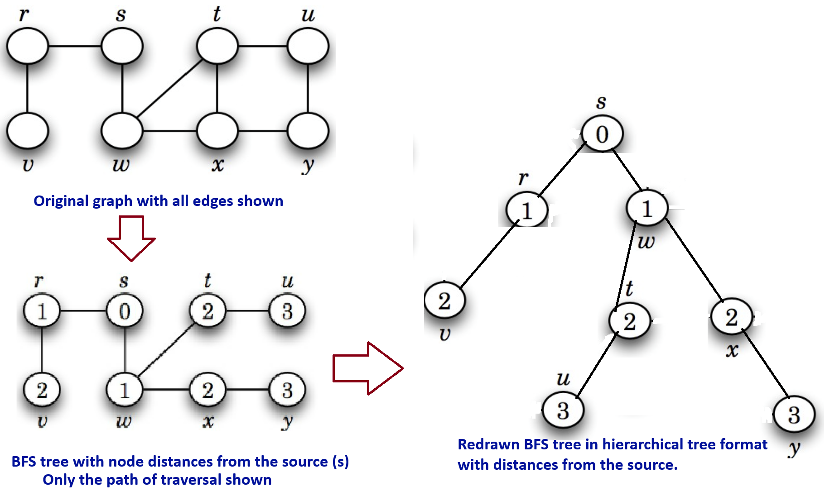
Breadth first search (BFS) Tree

Slide 23
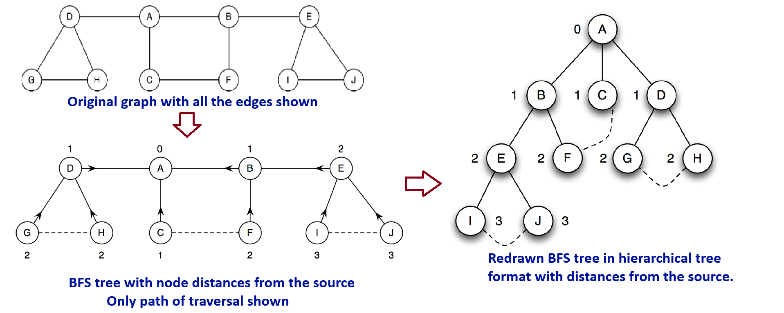
Breadth first search (BFS) Tree
Vertices are labeled with their distance from the source.
Arrows point to each vertex’s ancestor. [will be covered in Algorithms course]
Solid lines = tree edges; [will be covered in Algorithms course]
dashed lines = non-tree (back) edges in this undirected graph [will be covered in Algorithms course]

Slide 24
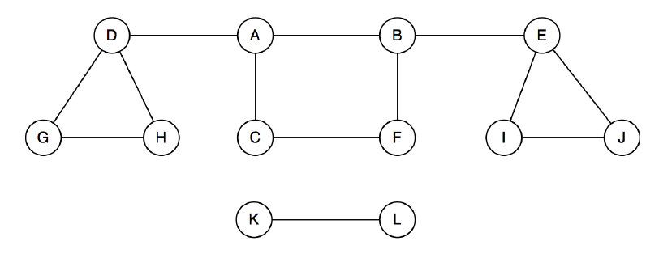
Breadth first search (BFS)
A single BFS from vertex A only visits vertices in its connected component.
Vertices K and L are not visited if they are not reachable from A.
To visit all vertices, perform BFS from each unvisited vertex in the graph.
  This approach identifies all connected components in the graph.

Slide 25
Breadth-first search - Analysis
Time Complexity of BFS
Outer while loop processes vertices (V) from the queue
Inner for loop examines all adjacent neighbors (E)
At first glance, this may look like nested loops
(suggesting higher complexity)
Nesting does not multiply time by V × E independently

Slide 26
Breadth-first search - Analysis
Time Complexity of BFS
Outer While Loop – Vertex Processing
  Each vertex enqueued & dequeued once → O(V)
Inner For Loop – Edge Processing
  Directed Graph: Each edge explored once → O(E)
  Undirected Graph: Each edge explored twice → O(2E) ≈ O(E)
  So, Time Required: O(E)
Overall Complexity
  Vertex processing = O(V)
  Edge processing = O(E)
  So, Total = O(V + E) (best, average, worst cases)

Slide 27
Breadth first search (BFS) Algorithm with explanation
BFS(G, s) // G = (V, E), s is the source vertex 1. for each vertex u in V: 2. u.d = ∞ // Set distance to infinity 3. u.p = NIL // Set parent to NIL 4. s.d = 0 // Set the distance of the source vertex to 0 5. Q = new Queue // Initialize an empty queue 6. Enqueue(Q, s) // Enqueue the source vertex 7. while Q is not empty: 8. u = Dequeue(Q) // Remove the front vertex from the queue 9. for each vertex v in Adj[u]: 10. if v.d == ∞: // If vertex v has not been visited 11. v.d = u.d + 1 // Set the distance of v 12. v.p = u // Set parent of v to u 13. Enqueue(Q, v) // Enqueue vertex v

Slide 28
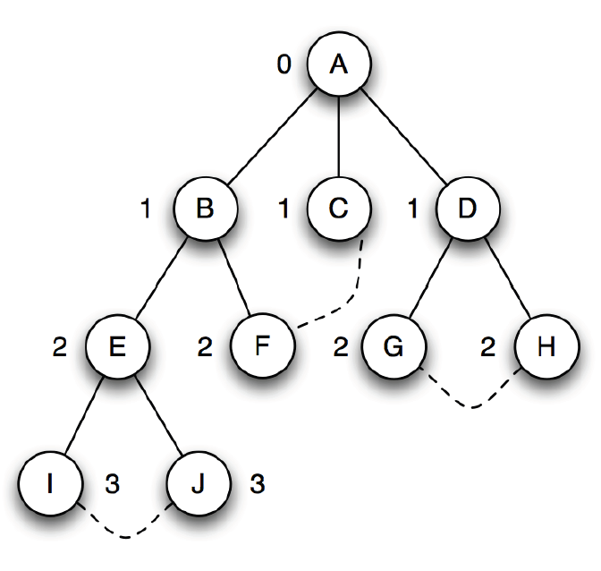
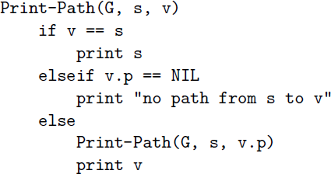
Breadth-first search - Printing a path from s to v
After BFS, we get a BFS tree where each path from the
root to a node shows the shortest path in G.
This tree shows how each vertex was reached from the source.
The predecessor info (u.π) stores the previous node on the path.
Using this info, we can easily reconstruct or print the path
from the source s to any node v.

Slide 29
Breadth-first search - Printing a path from s to v
BFS tree shows how each vertex was reached from the source.
The predecessor info (u.π) stores the previous node on the path.
Using this info, we can easily reconstruct or print the path
from the source s to any node v.

Slide 30
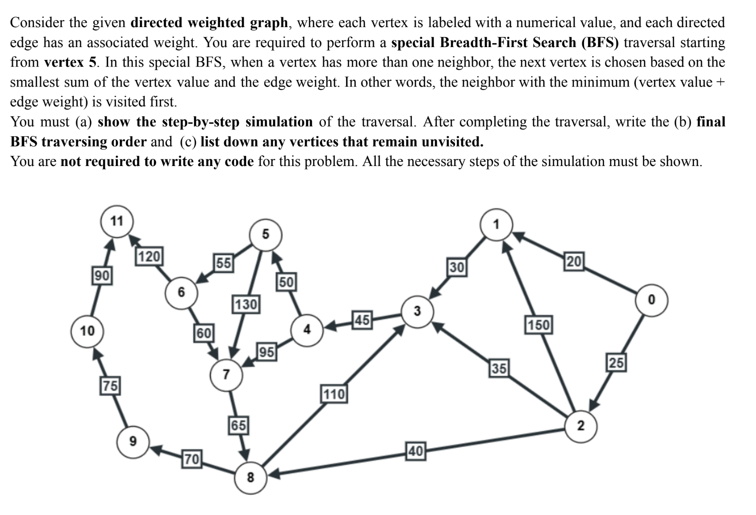
Homework

Slide 31
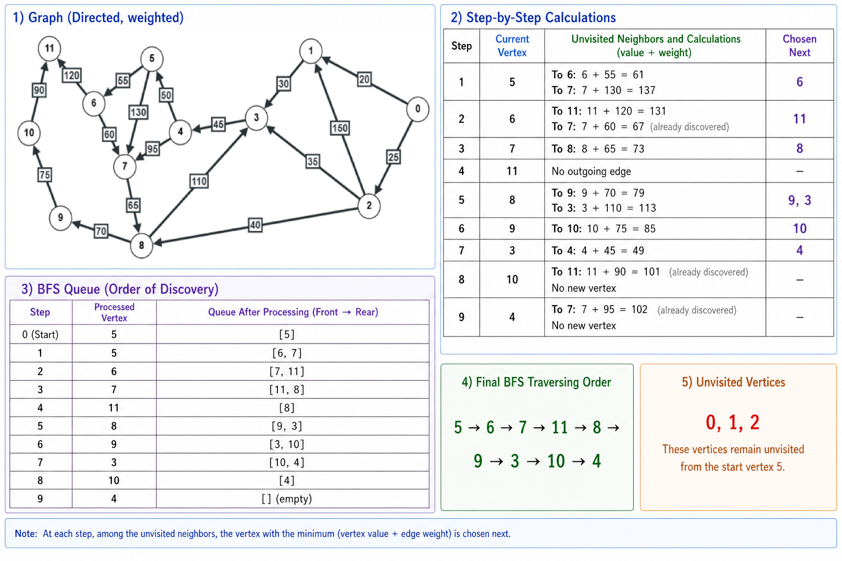
Homework

Slide 32
Applications of BFS
(Just know that these can be done)
Shortest Path (Unweighted Graph): Finding the shortest path in undirected or directed unweighted graphs using level-order traversal.
[Shown in previous slides]
Bipartiteness Check: Verifying if a graph can be divided into two disjoint sets using two-coloring.
Cycle Detection (Undirected Graph): Detecting cycles by checking for back edges during traversal.
Graph Connectivity: Checking whether all vertices are reachable from a given starting point. [Appeared in one of the Finals]
Implementation will be covered in CSE221

Slide 33
Use the following link to generate and traverse graphs: https://visualgo.net/en/dfsbfs
Interactive Graph Traversal with VisuAlgo

Slide 34
The End

